Slide 1




SUPPLY CHAIN MANAGEMENT

Slide 2
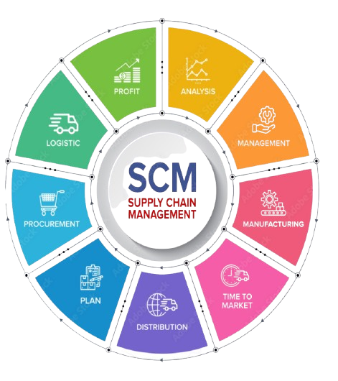

DASHBOARD KPI DESCRIPTION
Total Sales (MTD, QTD, YTD)
MTD (Month-to-Date): The cumulative sales value from the start of the current month
to the latest date available. Helps track monthly targets.
QTD (Quarter-to-Date): Total sales from the beginning of the current quarter. Useful for
analyzing quarterly trends and seasonality.
YTD (Year-to-Date): Accumulated sales from the start of the year. Provides a long-term
view of performance against annual goals.
2. Product-Wise Sales
Breaks down total sales across each product or product category. Helps identify top-performing
and low-performing SKUs.
Enables deeper analysis of product preferences, pricing effectiveness, and customer demand.
3. Sales Growth
Measures the percentage change in sales compared to previous time periods (e.g., month-
over-month or year-over-year).
A positive growth rate signals expanding business, while a negative rate highlights declining
performance.
Can be visualized with trend lines or bar charts to show momentum.

Slide 3
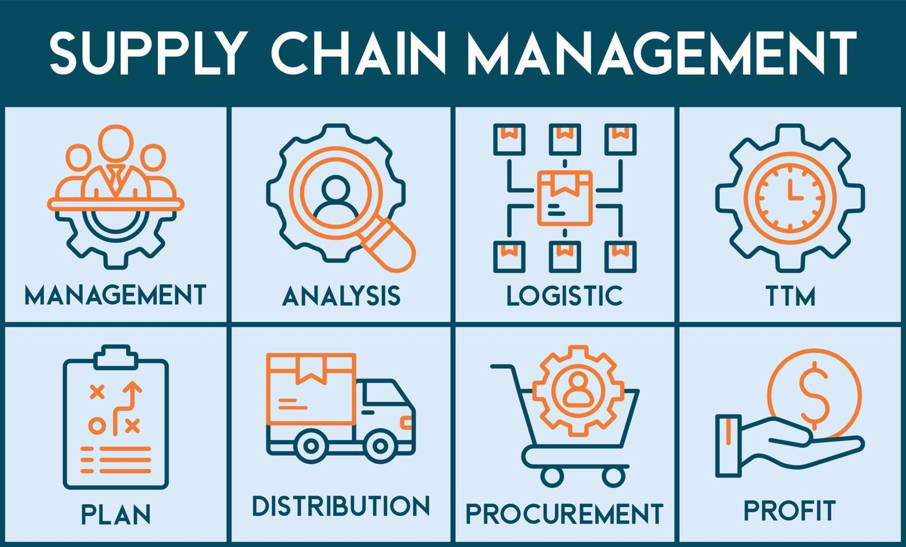
4. Daily Sales Trend
Shows sales performance for each day within a selected time frame.
Useful to: Identify peak sales days, Detect anomalies like sudden drops or spikes, Understand daily customer purchasing behavior.
5. State-Wise Sales
Displays sales figures segregated by geographical states.
Useful for regional strategy: Identify high-performing vs. underperforming regions, Optimize marketing and logistics efforts
based on demand hotspots.
6. Top 5 Store-Wise Sales
Highlights the five best-performing stores based on total sales.
Insights from top stores can be leveraged to:
Replicate best practices across other outlets.
Allocate inventory or promotional resources more efficiently.
7. Region-Wise Sales
Aggregates sales data by region (e.g., North, South, East, West).
Offers a broader view than state-level data.
Ideal for comparing performance across larger business zones or managing regional managers' KPIs.

Slide 4
8. Total Inventory
Indicates the total number of units currently available in stock across all warehouses or stores. Helps assess if the supply chain is adequately supporting demand.
9. Inventory Value
The total monetary value of current inventory, usually calculated as: Inventory Quantity × Unit Cost
Important for financial reporting and cost control.
10. Inventory Health: Overstock, Out-of-Stock, Understock
In-Stock: Inventory in hand is ≥ 0 units — product is available.
Out-of-Stock: Inventory in hand is < 0 — product is unavailable, leading to potential lost sales.
Understock: Inventory in hand is less than required stock quantity, but not zero — risk of going out of stock if demand surges.
Overstock: Excess inventory beyond expected demand — ties up capital and increases holding costs.
11. Purchase Method-Wise Sales
Breakdown of sales based on purchasing channels or methods, such as: Online, In-store, Phone orders, App-based
Helps understand customer buying behavior and optimize channel strategies.

Slide 5

Excel-Specific Challenges
Challenge | Details
🚫 Limited Scalability | Slows down with large datasets or multiple charts/pivots
🎛️ Basic Interactivity | Lacks dynamic filtering unless slicers or form controls are used
🧩 No Real-Time Data | Requires manual or semi-automated data imports
📉 Basic Visualizations | Lacks advanced visuals like forecasting, drill-downs, etc.
🔄 Manual Refresh | Power Query can help, but still less automated than BI tools

Slide 6


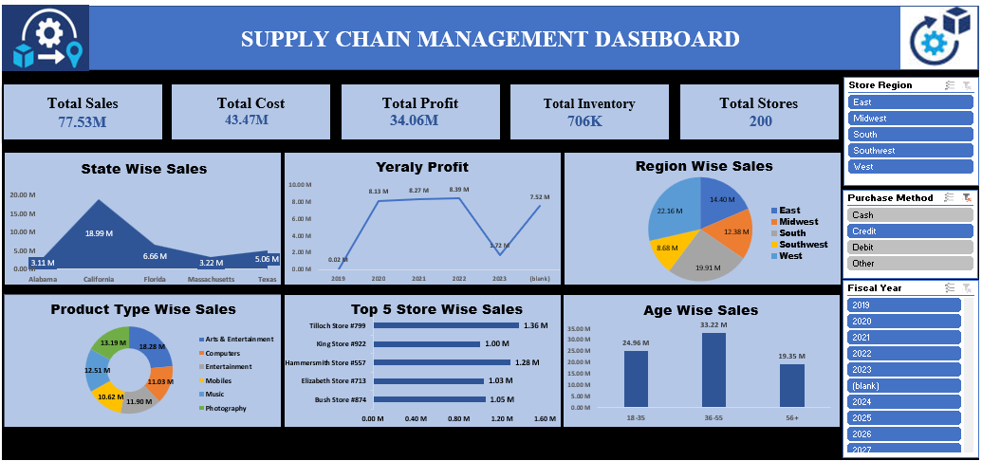
Excel Dashboard

Slide 7

Power BI Specific Challenges
Challenge | Details
💰 Licensing Costs | Pro features require a subscription (e.g., for sharing dashboards)
🧠 Learning Curve | DAX formulas and data modeling can be complex
🌐 Data Integration Setup | SQL Server, APIs, Excel must be properly connected
📉 Limited Custom Charting | Visual customization is somewhat limited compared to Tableau
⚠️ Performance on Complex Models | Poorly structured models can slow performance

Slide 8
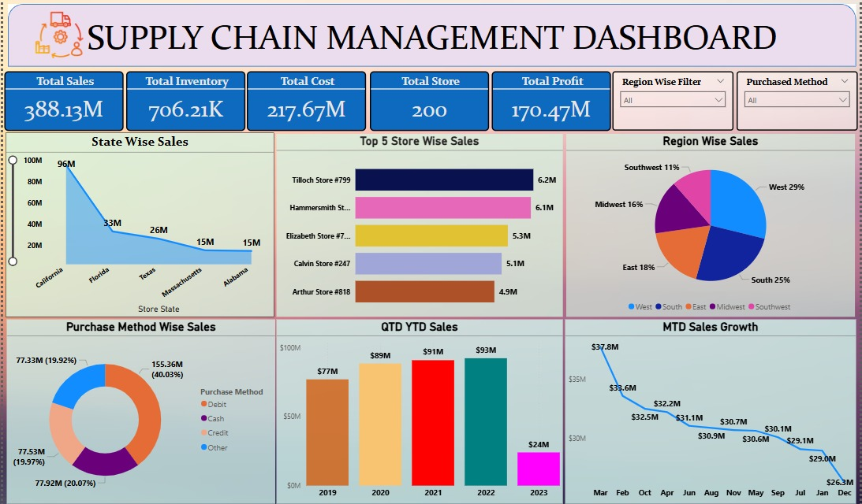
Power BI Dashboard

Slide 9

Tableau Specific Challenges
Challenge | Details
💵 High Licensing Costs | Professional version can be expensive for small teams
📚 Steep Learning Curve | Complex dashboards and calculations require learning Table Calculations
🔄 Manual Prep Without Prep Tool | Cleaning raw data requires Tableau Prep (a separate product)
⚙️ Slow for Large Data Sets | Performance issues if not optimized with extracts
🔗 Live Connection Limitations | Can lag with real-time SQL data if not tuned properly

Slide 10
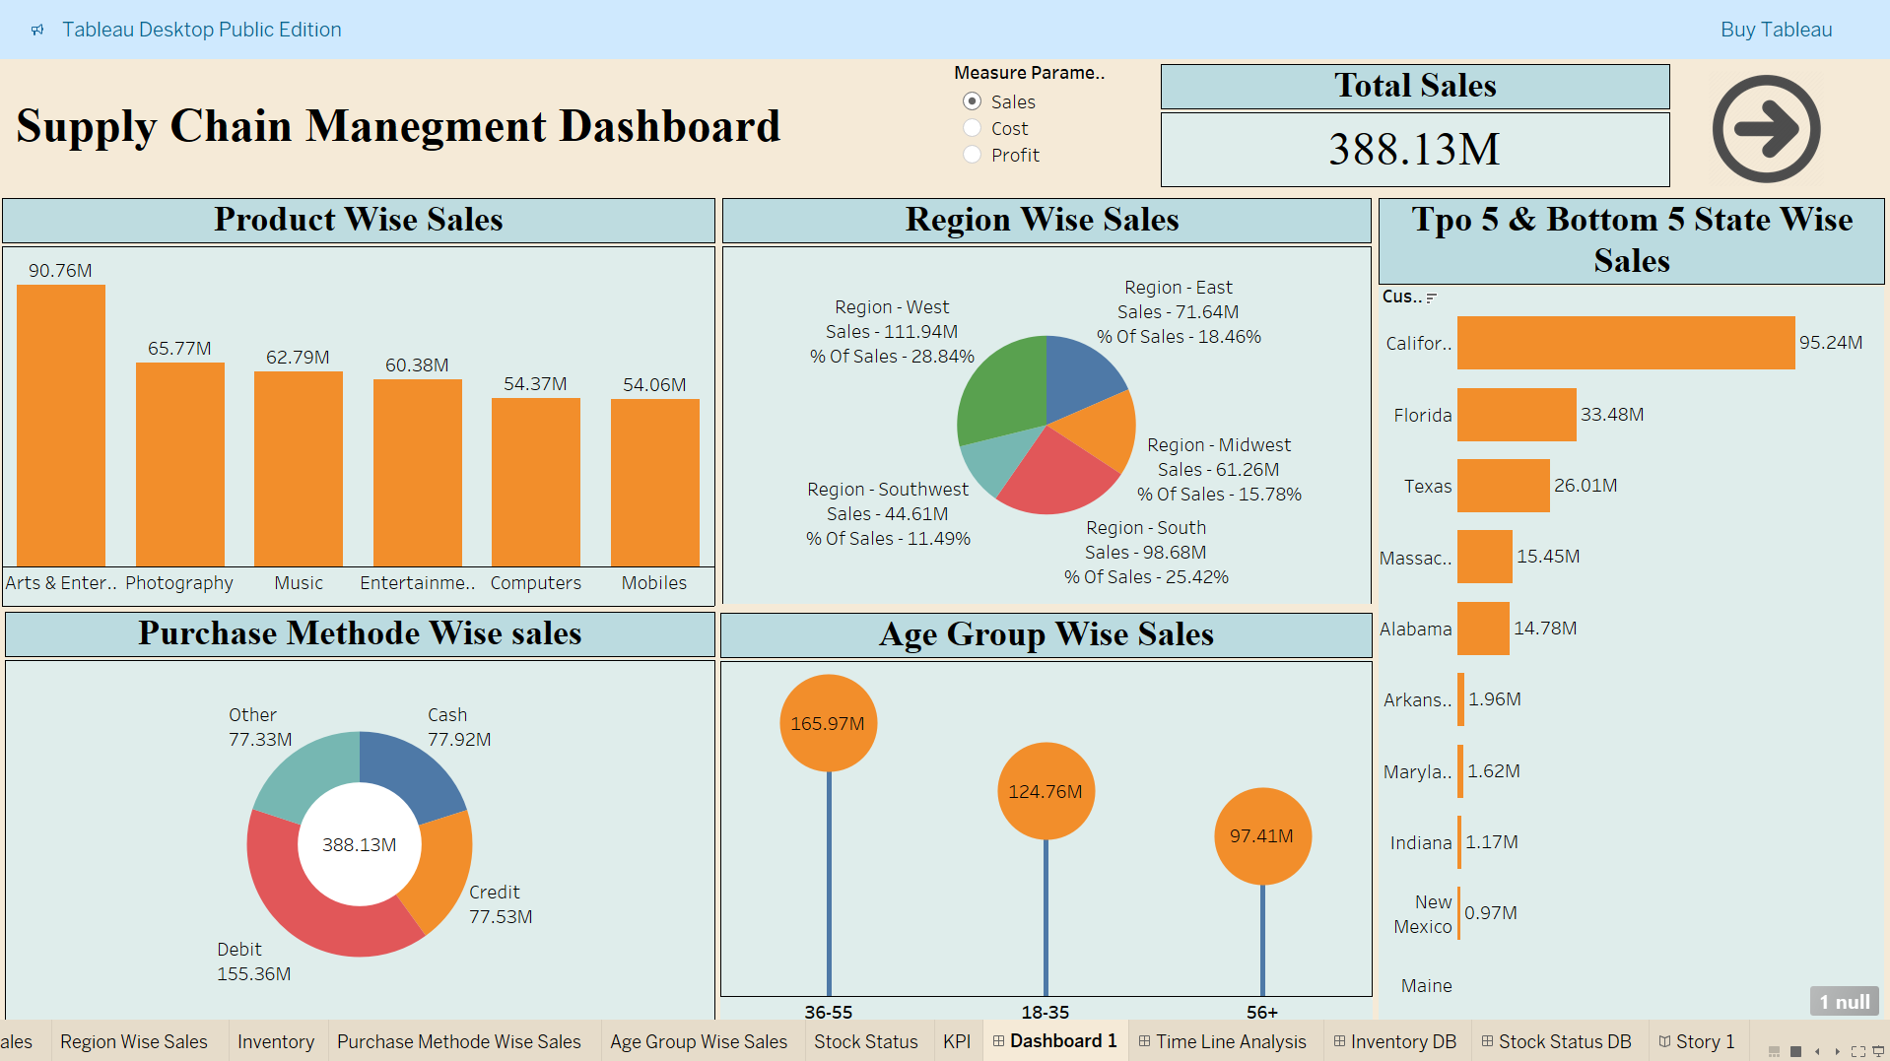
Tableau Dashboard

Slide 11

SQL Specific Challenges
Challenge | Details
Data Inconsistencies | Professional version can be expensive for small teams
🔗 Complex Joins | Writing multi-table joins without duplicating or missing data is error-prone
🔄 Performance bottleneck | Slow query execution with large data sets or lack of indexing
⚙️ Version Control Conflicts | No centralized system to manage and merge SQL scripts collaboratively
🔗 Limited DB access | Not all members have equal access or permissions to query the database

Slide 12
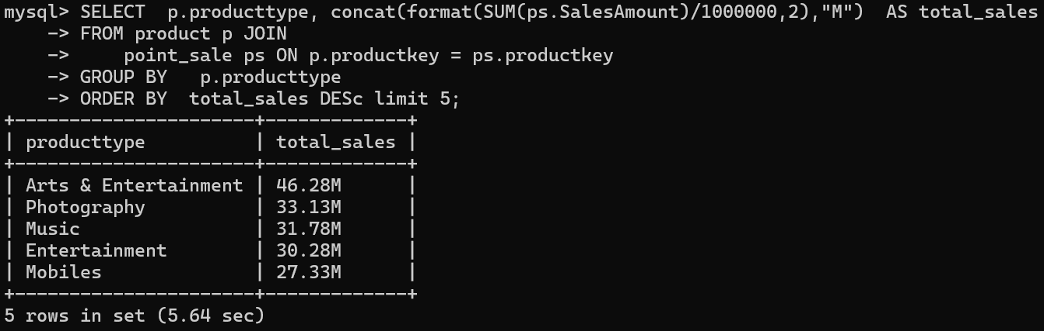
SQL Queries
Product Type wise Sales

Slide 13
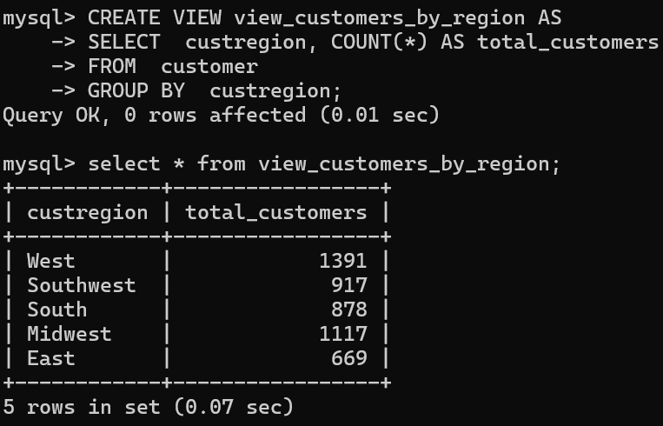
SQL Queries
View: Total Customers by Region

Slide 14
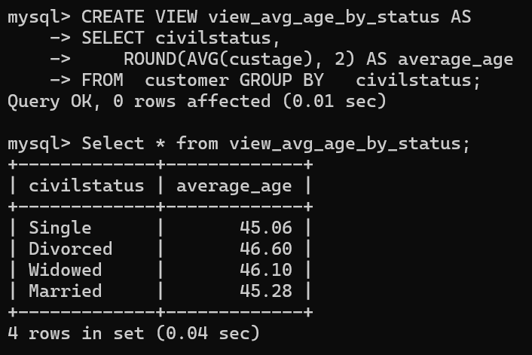
SQL Queries
View: Average Age by Civil Status

Slide 15
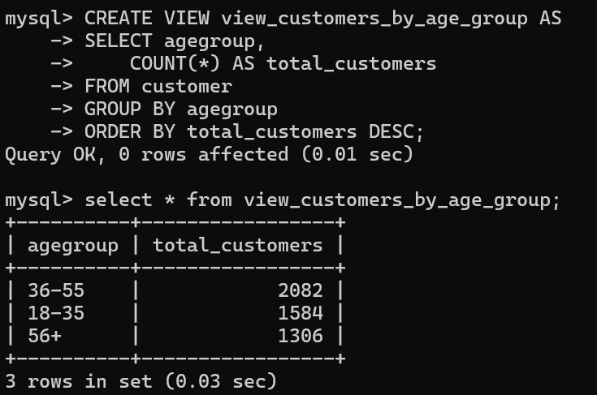
SQL Queries
View: Customers by Age Group

Slide 16
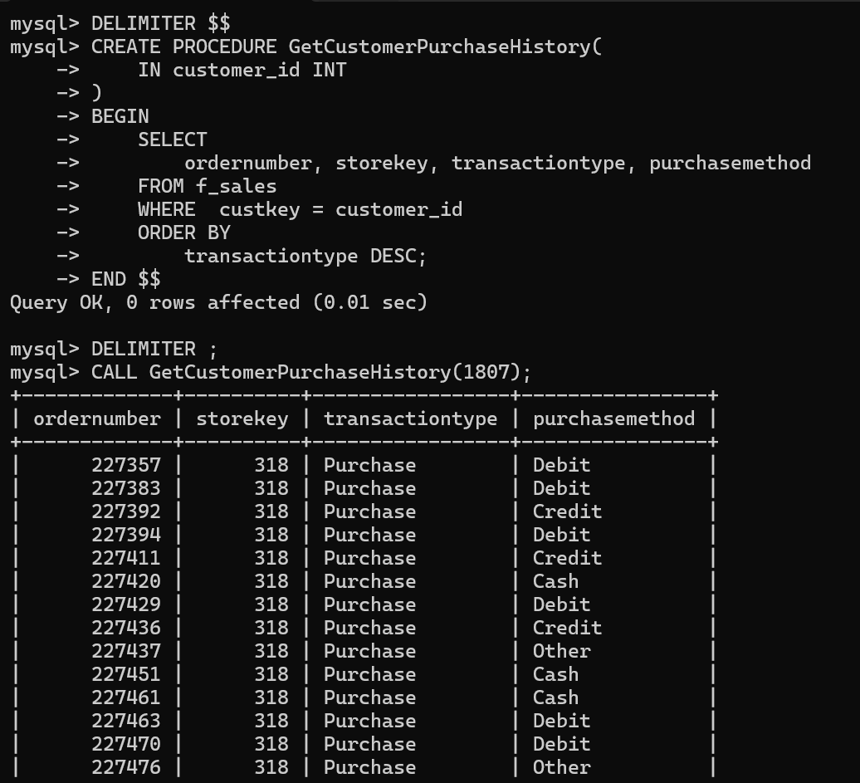
SQL Queries
Procedure: Get Customer Purchase History

Slide 17

CHALLENGES FACED AND POTENTIAL SOLUTIONS
Key Roadblocks Encountered During the Project
Data Cleaning & Preprocessing: Standardized and cleaned datasets to ensure analytical accuracy.
Dashboard Optimization: Streamlined presentation using efficient visualization tools.
Alternative Tools & Workarounds: Identified and implemented supporting tools/plugins to address technical limitations.
Regular Team Meetings: Conducted structured daily/weekly check-ins for coordination.
Task Prioritization: Delegated responsibilities strategically to manage workload and meet timelines.
Iterative Feedback Implementation: Incorporated feedback in phases to prevent last-minute disruptions.
Lessons Learned from Overcoming Obstacles
Early Planning Reduces Risks: Proactive scheduling helps avoid last-minute issues.
Communication Drives Collaboration: Clear, regular communication improves alignment.
Adaptability is Essential: Flexibility with tools and methods resolves unforeseen challenges.
Gradual Feedback Integration: Phased feedback ensures stability and quality.
Teamwork Enhances Results: Strong collaboration leads to better outcomes.

Slide 18
THANK YOU!

